Slide 1
Applied Data Capstone

Slide 2
Data & Methodology
Data that will identify the perfect location to open the gym in Brooklyn.
A listing of neighborhoods by ZIP Code obtained from:(https://geo.nyu.edu/catalog/nyu_2451_34572)
Latitude/Longitude data provided via Cognitive Class (https://cocl.us/Geospatial_data)
New York city data accessible through the FourSquare API
The data will identify the list of the businesses/venues in the neighborhood.
List neighborhoods along with the top 10 most common venues.
Use clustering method to determine which neighborhoods are best for opening a gym.

Slide 3
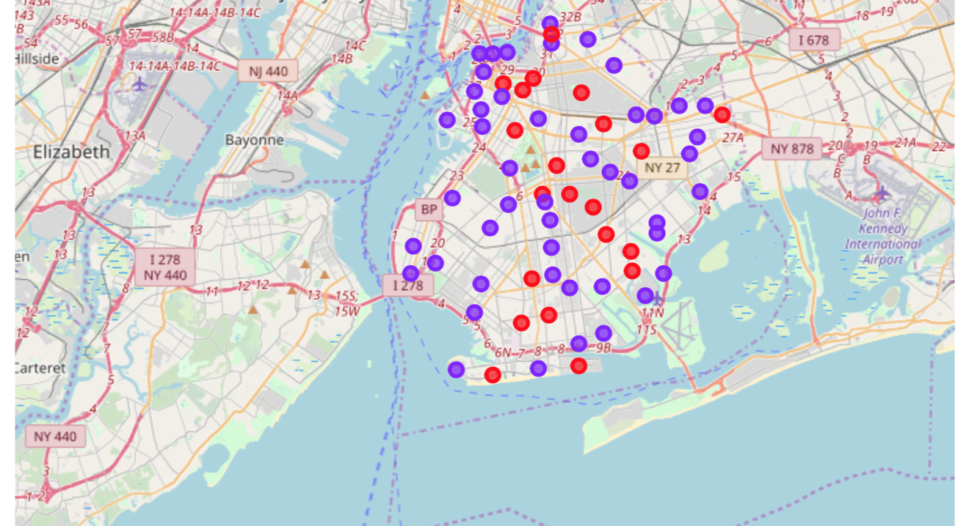
Clusters

Slide 4
Conclusion
Red neighborhoods are best primed for new gym.
In 61.9% of the Red neighborhood, gym is does not fall into the top ten frequented places by the residents.

